Slide 1

First Idea Presentation
Gunakar Challa

Slide 2
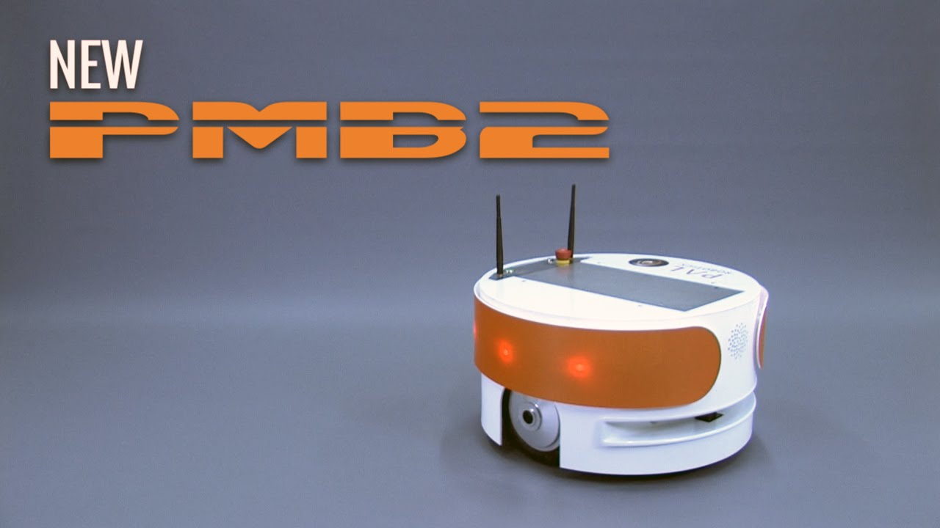
Surveillance Robot using PMB2

Slide 3
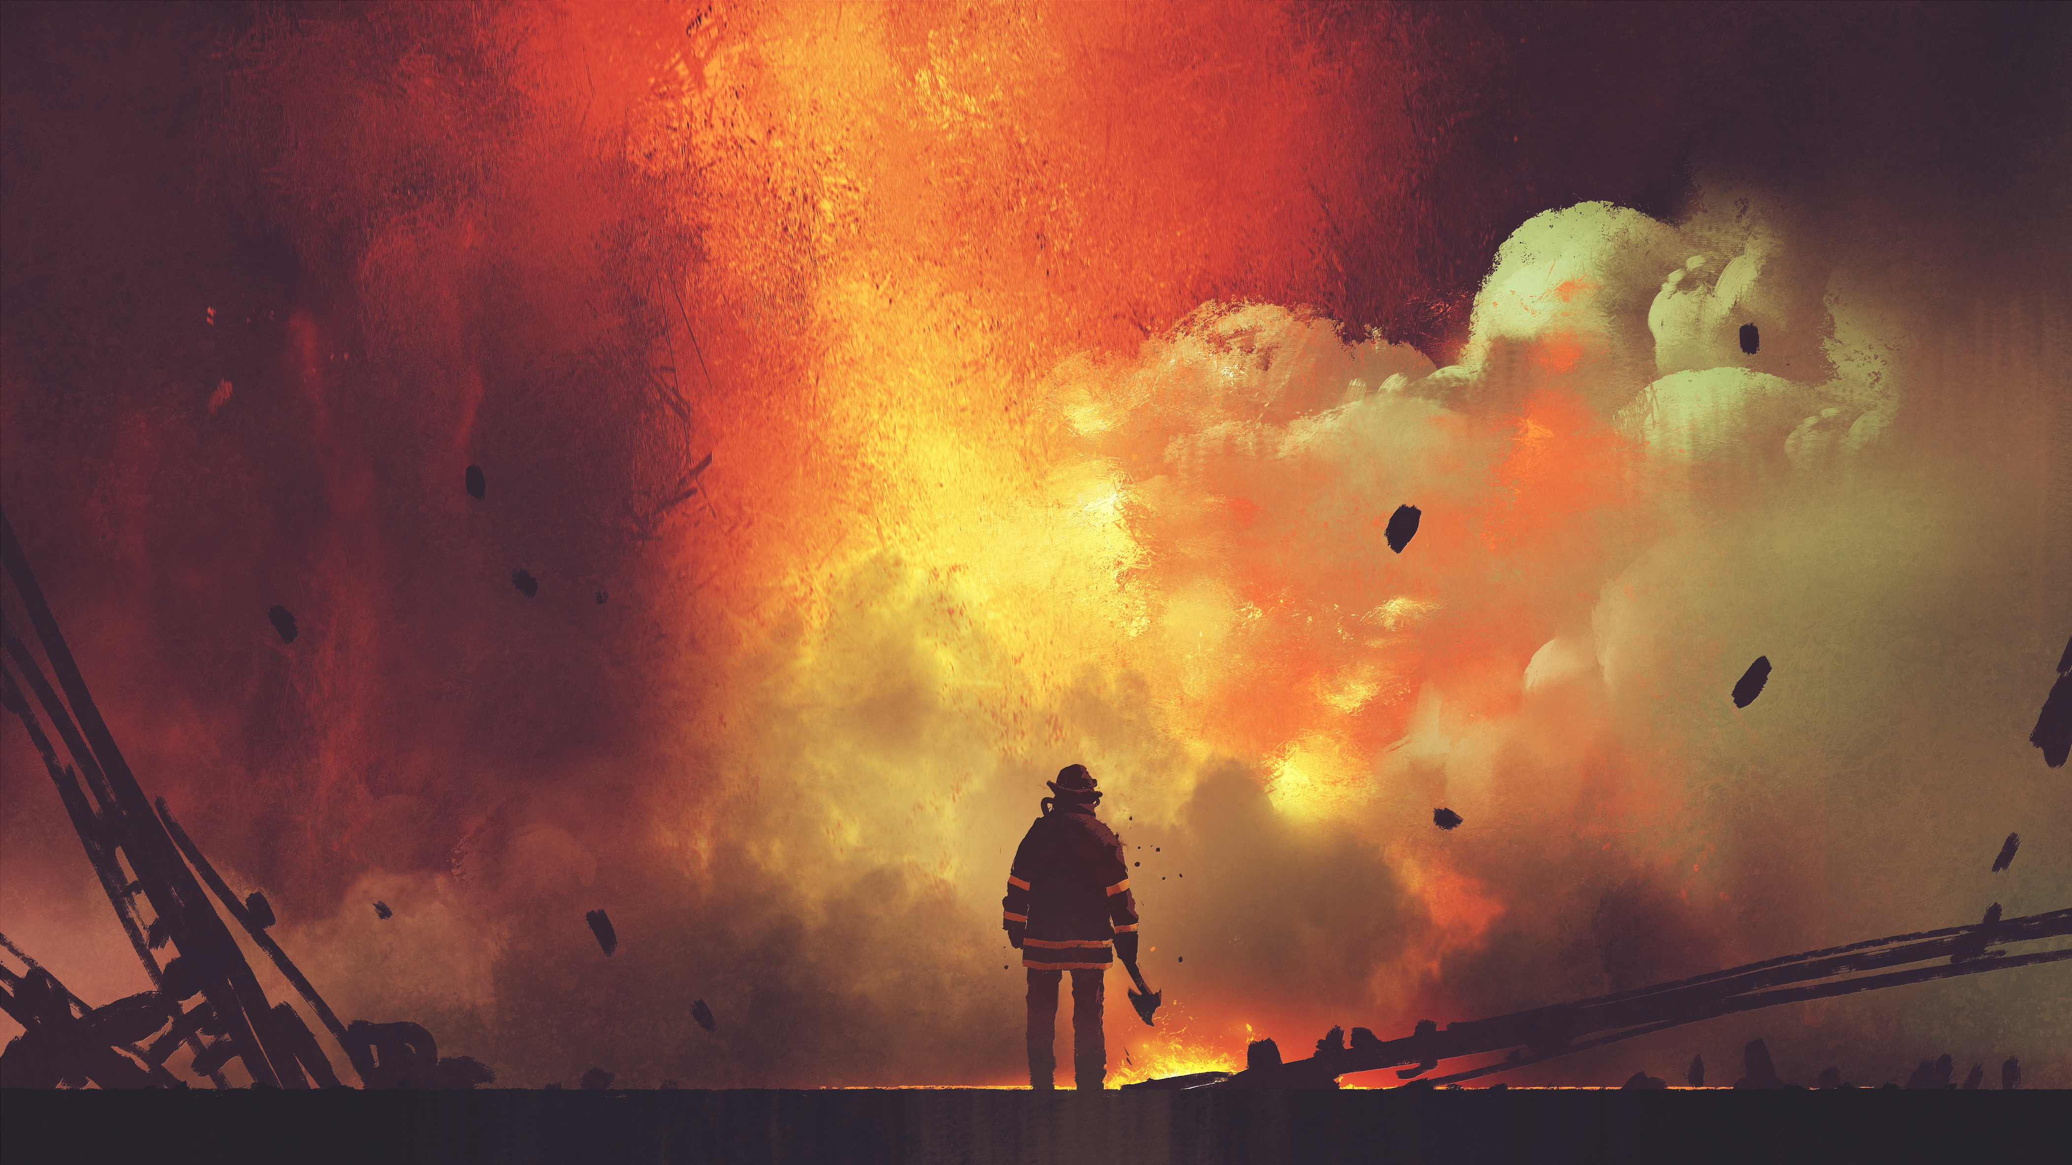

Purpose
There are several situations where a humans may not enter the zone which needs observance.
The reasons can vary from severe weather conditions (-20C) to disaster stroked areas(Fire accident) to covert operations and so on...
We shall use a normal camera but this prototype can be extended using IR cameras which enables us to use it during night and extreme smoke.

Slide 4

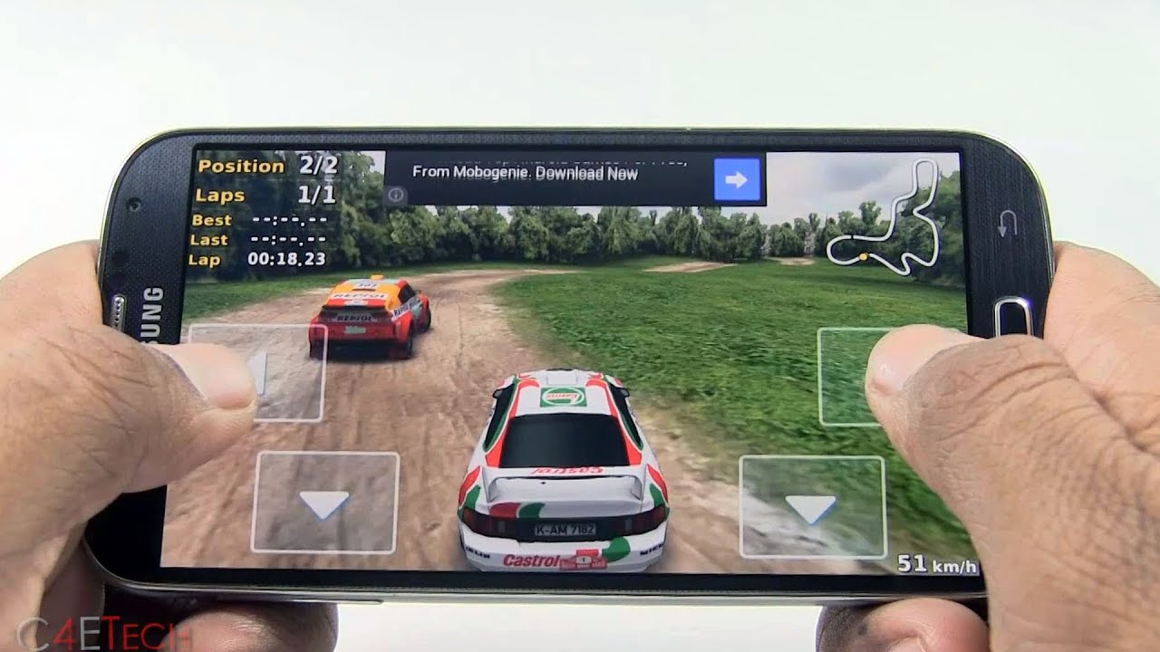
Interface
The user uses his/her smarphone to control the robot.
The UI of the application shows a real-time video stream from the robot and provides buttons to control the same.
Similar to a video game!!!

Slide 5
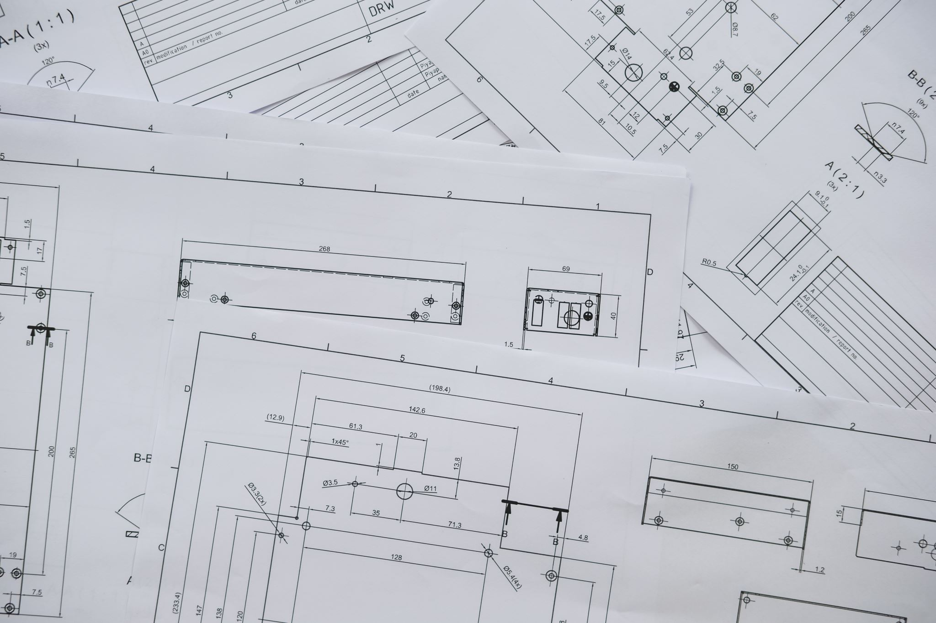

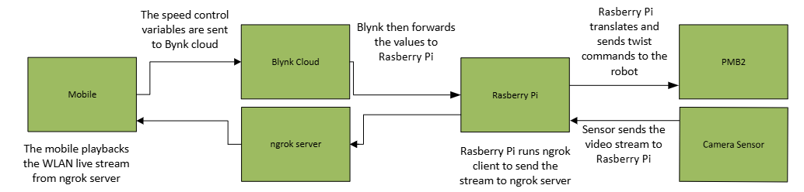
Architecture/Technical Realisation
The frontend controller application is realized using Blynk IoT.
Blynk cloud acts as backend for the mobile application. It also acts as a middleware to send and receive the data from the Arduino.
Camera sensor is attached to the Arduino and sends the video stream.
Twist commands are sent to PMB2 robot to control it.

Slide 6



Technical Difficulties
The main problem for lies in live streaming the video feed. Streaming is very different from playing a video.
Send twist commands from Rasberry Pi to PMB2 is still not fully clear.
Making the project WLAN compatible requires additional overhead on top of LAN configuration.
Latency can be an issue.

Slide 7

Discussions

